Slide 1
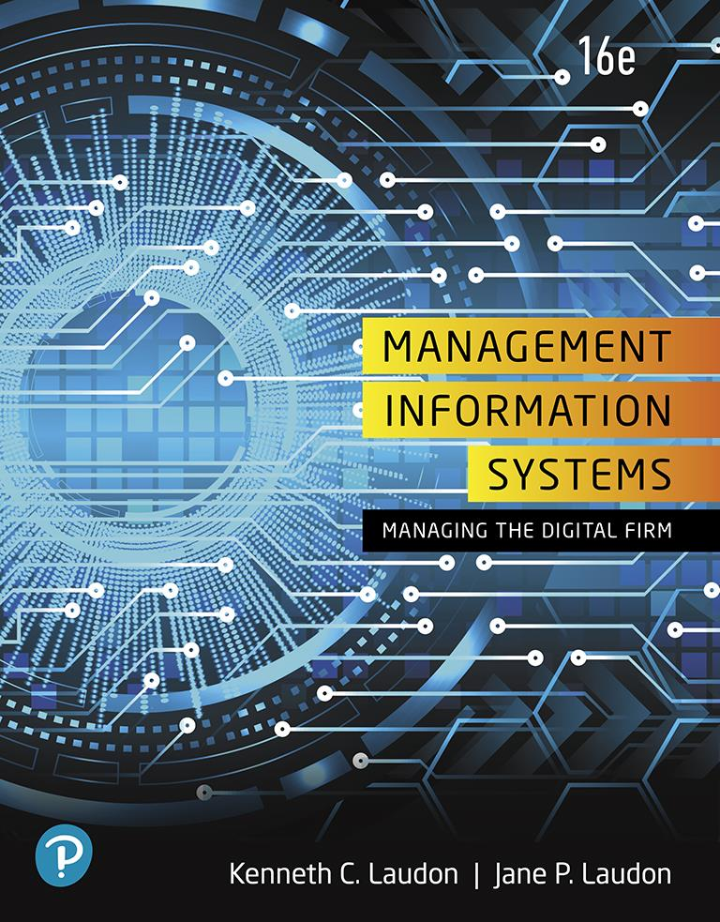
Management Information Systems: Managing the Digital Firm
Sixteenth Edition
Chapter 12
Enhancing Decision Making
Copyright © 2020, 2018, 2016 Pearson Education, Inc. All Rights Reserved
Notes:
If this PowerPoint presentation contains mathematical equations, you may need to check that your computer has the following installed:
1) MathType Plugin
2) Math Player (free versions available)
3) NVDA Reader (free versions available)

Slide 2
Learning Objectives
12.1 What are the different types of decisions, and how does the decision making process work?
12.2 How do information systems support the activities of managers and management decision making?
12.3 How do business intelligence and business analytics support decision making?
12.4 How do different decision-making constituencies in an organization use business intelligence, and what is the role of information systems in helping people working in a group make decisions more efficiently?
12.5 How will M I S help my career?
Notes:
This chapter focuses on the information systems that support decision making in a firm and discusses the value of improved decision making in an organization. Ask the students to describe different types of decisions and whether some types of decisions are less valuable than others. What types of decisions, in a work framework, have students encountered in their own employment situations? Ask students to describe some of the decisions they made on their last job. How did they use information systems to help make those decisions?

Slide 3
Video Cases
Case 1: P S E G Leverages Big Data and Business Analytics Using G E’s PREDIX Platform
Case 2: FreshDirect Uses Business Intelligence to Manage Its Online Grocery
Case 3: Business Intelligence Helps the Cincinnati Zoo Work Smarter

Slide 4
Big Data and the Internet of Things Drive Precision Agriculture (1 of 2)
Problem
Explosive population growth
Opportunities from new technology
Solutions
Identify technologies
Develop improvements for farmer processes
IoT wireless sensors
Supercomputer processing
Analytic software
Web links to farmers

Slide 5
Big Data and the Internet of Things Drive Precision Agriculture (2 of 2)
Precision Agriculture Systems
Demonstrates I T’s role in providing information and business intelligence that help small business like farmers improve efficiency
Illustrates how information systems can improve an entire industry

Slide 6
What Are the Different Types of Decisions, and How Does the Decision Making Process Work? (1 of 2)
Business value of improved decision making
Improving hundreds of thousands of “small” decisions adds up to large annual value for the business
Types of decisions
Unstructured: Decision maker must provide judgment, evaluation, and insight to solve problem
Structured: Repetitive and routine; involve definite procedure for handling so they do not have to be treated each time as new
Semistructured: Only part of problem has clear-cut answer provided by accepted procedure
Notes:
This slide discusses the importance of improved decision making and describes the three types of decisions that are made in an organization. Table 12-1 in the text illustrates how a small decision made hundreds of times a year can be just as valuable as a single decision made once a year. For example, the decision to schedule production to fill orders, made 150 times a year, with a value of $10,000 if this decision is improved, can mean an annual value of $1.5 million. The different levels in an organization tend to make different types of decisions, and require different types of support to make these decisions. Ask students to provide examples of each type of decision. Give students examples of decisions and ask what category the decision fall into and why.

Slide 7
What Are the Different Types of Decisions, and How Does the Decision Making Process Work? (2 of 2)
Senior managers
Make many unstructured decisions
Middle managers
Make more structured decisions but these may include unstructured components
Operational managers and rank and file employees
Make more structured decisions
Notes:
This slide describes the types of decisions being made at the different levels within an organization. Semistructured decisions contain a portion that is unstructured and a portion that is structured. Which portion of the example question for middle managers is structured and which is unstructured? What would make this question a fully structured question? Ask students to come up with additional examples of decisions at the executive, middle management, and operational levels of the organization, for companies they have worked for.

Slide 8
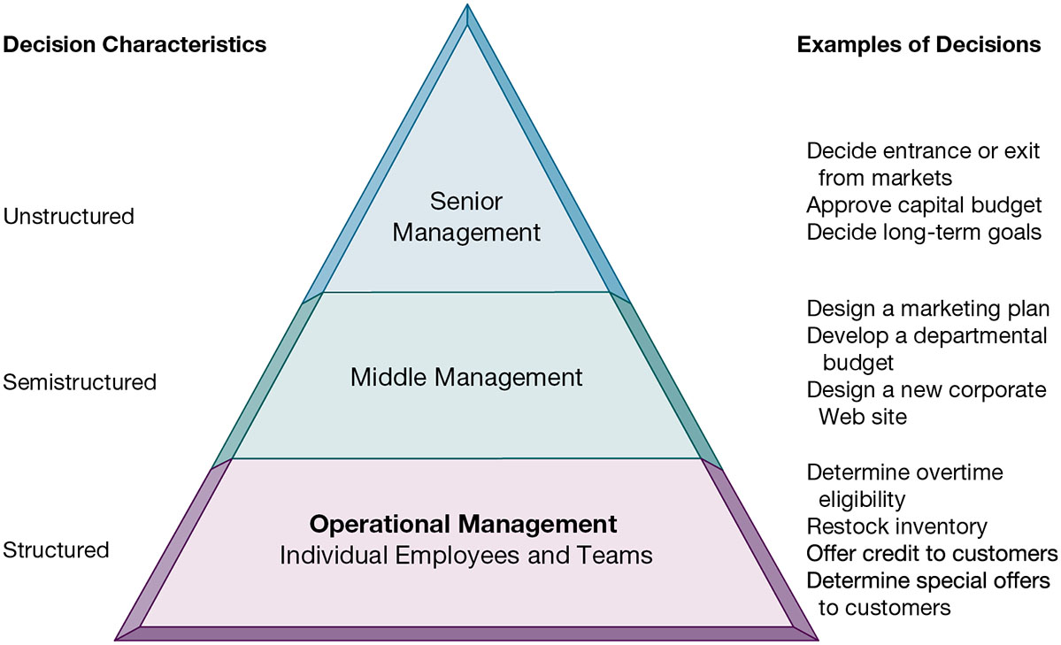
Figure 12.1 Information Requirements of Key Decision-Making Groups in a Firm
Notes:
Figure 12.1, Page 462.
Senior managers, middle managers, operational managers, and employees have different types of decisions and information requirements.
This figure provides an illustration of how the nature of decision making changes as you move up and down the corporate hierarchy. There are of course exceptions. Some senior managers like to take a hands-on approach to daily operations.
Full description: A pyramid diagram depicts levels of decisions. At the bottom of the pyramid is operational management, the individual employees and teams who make decisions with structured characteristics. Examples include determining overtime eligibility, restocking inventory, offering credit to customers, and determining special offers to customers. In the middle of the pyramid is middle management, who make decisions with semistructured characteristics. Examples include designing a marketing plan, developing a departmental budget, and designing a new corporate website. At the top of the pyramid is senior management, who make decisions with unstructured characteristics. Examples include deciding entrance or exit from markets, approving capital budget, and deciding long term goals.

Slide 9
The Decision Making Process
Intelligence
Discovering, identifying, and understanding the problems occurring in the organization
Design
Identifying and exploring solutions to the problem
Choice
Choosing among solution alternatives
Implementation
Making chosen alternative work and continuing to monitor how well solution is working
Notes:
This slide describes the process of decision making as a series of four stages. It is important to note that if an implemented solution doesn’t work, the decider can return to an earlier stage in the process and repeat as needed. Give the students an example decision, such as “what college should I apply to” and ask them to describe the actions taken at each of the four stages.

Slide 10
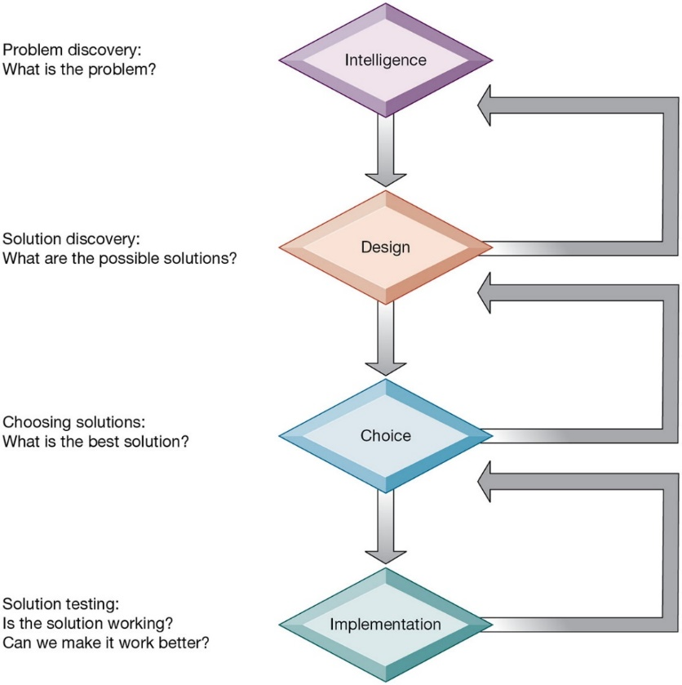
Figure 12.2 Stages in Decision Making
Notes:
Figure 12.2, Page 464.
The decision-making process is broken down into four stages.
This graphic illustrates the four stages of decision making introduced in the previous slide, emphasizing that steps can be repeated as needed, depending on the outcome at each stage.
Full description: A flowchart depicts four stages in decision making. Stage 1. Intelligence, Problem discovery. What is the problem? Stage 2. Design, Solution discovery. What are the possible solutions? Stage 3. Choice, Choosing solutions. What is the best solution? Stage 4. Implementation, Solution testing. Is the solution working? Can we make it work better?

Slide 11
Managerial Roles
Information systems can only assist in some of the roles played by managers
Classical model of management: five functions
Planning, organizing, coordinating, deciding, and controlling
More contemporary behavioral models
Actual behavior of managers appears to be less systematic, more informal, less reflective, more reactive, and less well organized than in classical model
Notes:
This slide discusses the idea that, although information systems can assist in making decisions by providing information and tools for analysis, they cannot always improve on decisions being made. Ask the students to provide examples of decisions that an information system might not be able to assist in. Is there any similarity among these example decisions, and what does this say about the types of decisions an information system can help with?
You can understand the complexity and breadth of some of the decisions being made within an organization by looking at the activities of its managers. Although the classical model of management sees five functional roles of managers, real-life observation of managers sees far more complexity in managerial activities. Ask the students to recall the five attributes listed in the book as differing greatly from the classical description. (1) Managers perform a great deal of work at an unrelenting pace; (2) managerial activities are fragmented, lasting for less than 9 minutes; (3) managers prefer current, specific, ad hoc information; (4) managers prefer oral forms of communication; and (5) managers give high priority to maintaining a complex web of contacts as an informal information system. Ask students to explain attributes 3, 4, and 5.

Slide 12
Mintzberg’s 10 Managerial Roles (1 of 2)
Interpersonal roles
Figurehead
Leader
Liaison
Informational roles
Nerve center
Disseminator
Spokesperson
Notes:
This slide expands on the behavioral model of managers and describes Mintzberg’s behavioral model of managers which defines 10 managerial roles that fall into three categories. Ask students to give examples of activities for each role. Which of these roles can be assisted by information systems and which cannot?

Slide 13
Mintzberg’s 10 Managerial Roles (2 of 2)
Decisional roles
Entrepreneur
Disturbance handler
Resource allocator
Negotiator
Notes:
This slide expands on the behavioral model of managers and describes Mintzberg’s behavioral model of managers which defines 10 managerial roles that fall into three categories. Ask students to give examples of activities for each role. Which of these roles can be assisted by information systems and which cannot?

Slide 14
Real-World Decision Making
Three main reasons why investments in I T do not always produce positive results
Information quality
High-quality decisions require high-quality information
Management filters
Managers have selective attention and have variety of biases that reject information that does not conform to prior conceptions
Organizational inertia and politics
Strong forces within organizations resist making decisions calling for major change
Notes:
Even in decision-making situations that can be helped by information systems, the information system may fail in helping to solve the problem or lead to a better decision. This slide describes the three main reasons why investments in information systems do not always produce positive results. What is meant by information quality? The text lists seven quality dimensions: accuracy, integrity, consistency, completeness, validity, timeliness, accessibility. Ask students to identify and/or describe these dimensions?
Ask students to provide an example of what a management “filter” might be. Have they ever witnessed someone in a managerial position be unable to recognize or handle a problem because of a “filter” they are using (but don’t even know it)?
Ask students why people within an organization would resist using an information system.

Slide 15
High-Velocity Automated Decision Making
Made possible through computer algorithms precisely defining steps for a highly structured decision
Humans taken out of decision
For example: High-speed computer trading programs
Trades executed in 30 milliseconds
Require safeguards to ensure proper operation and regulation
Notes:
This slide looks at the growth of systems for executing high-velocity decision making, such as financial trading programs. A second example is Google’s search engine. What types of problems lend themselves to this type of system? Ask students what other activities would benefit from humans being taken out of the decision-making process.

Slide 16
What is Business Intelligence?
Business intelligence
Infrastructure for collecting, storing, analyzing data produced by business
Databases, data warehouses, data marts
Business analytics
Tools and techniques for analyzing data
O L A P, statistics, models, data mining
Business intelligence vendors
Create business intelligence and analytics purchased by firms
Notes:
This slide introduces the concept of business intelligence and analytics. The text gives the example of Hallmark Cards, which uses SAS analytics software to analyze buying patterns and determine the most effective marketing plan for different types of customers. For example, which customers would respond best to direct mail or e-mail, and to what types of messages. It is important to understand that business intelligence and business analytics are products defined by hardware and software vendors. This is also one of the fastest growing segments in the U.S. software environment. Ask students why this might be so.

Slide 17
The Business Intelligence Environment
Six elements in the business intelligence environment
Data from the business environment
Business intelligence infrastructure
Business analytics toolset
Managerial users and methods
Delivery platform—M I S, D S S, E S S
User interface
Data visualization tools
Notes:
This slide looks at the six main elements at play in business intelligence. Ask students what is meant by managerial users and methods and why this is important. (Managers impose order on the analysis of data using a variety of managerial methods that define strategic business goals and specify how progress will be measured. Without management oversight, business analytics can produce a great deal of information that focus on the wrong matters and divert attention from the real issues. As the text notes, so far, only humans can ask intelligent questions.)

Slide 18
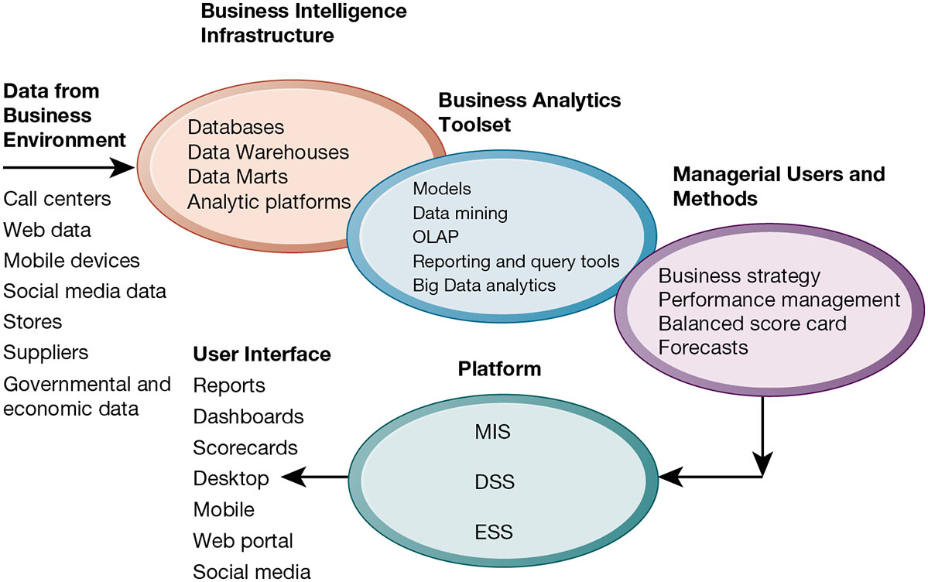
Figure 12.3 Business Intelligence and Analytics for Decision Support
Notes:
Figure 12.3, Page 469.
Business intelligence and analytics require a strong database foundation, a set of analytic tools, and an involved management team that can ask intelligent questions and analyze data.
This graphic looks at the different elements in the business intelligence environment; from left clockwise: Data, infrastructure, toolset, managerial users, platform, and user interface. This is an overview highlighting the kinds of hardware, software, and management capabilities that the major vendors offer and that firms develop over time.
Full description: A diagram presents the foundations, tools and supports for decision making systems. The business intelligence environment entails the following aspects. Data from Business Environment, including call centers, Web data, mobile devices, social media data, stores, suppliers, government and economic data. Business intelligence infrastructure, including databases, data warehouses, data marts, analytic platforms. Business analytics toolset, including models, data mining, O L A P, reporting and query tools, Big Data analytics. Managerial users and methods, including business strategy, performance management, balanced score card, forecasts. Platform, including M I S, D S S, E I S. User interface, including reports, dashboards, scorecards, desktop, mobile, Web portal, social media.

Slide 19
Business Intelligence and Analytics Capabilities
Goal is to deliver accurate real-time information to decision makers
Main analytic functionalities of B I systems
Production reports
Parameterized reports
Dashboards/scorecards
Ad hoc query/search/report creation
Drill down
Forecasts, scenarios, models
Notes:
This slide looks at the main functionalities of business intelligence systems. Parameterized reports are reports that can be adjusted to reflect user-defined parameters. The text gives the example of viewing a report by region and time of day to see how sales vary by these parameters. Ask students what is meant by drill down and give an example (the ability to move from a high level view summary to a detailed view). For example, a summary view might present the total numbers of products by category sold worldwide. Drilling down, views might go to products sold at national, regional, and local levels, and down from product categories to single products and product versions.

Slide 20
Interactive Session: Technology: Siemens Makes Business Processes More Visible
Class discussion
How did information technology change the game of 1. Identify the problem in this case study. What management, organization, and technology factors contributed to the problem?
Describe the capabilities of process mining software. Was this an effective solution? Explain your answer.
How did process mining change decision making at Siemens?
What management, organization, and technology issues need to be addressed when implementing process mining systems?

Slide 21
Table 12.4 Examples of Business Intelligence Predefined Production Reports
Business Functional Area | Production Reports
Sales | Forecast sales; sales team performance; cross-selling; sales cycle times
Service/call center | Customer satisfaction; service cost; resolution rates; churn rates
Marketing | Campaign effectiveness; loyalty and attrition; market basket analysis
Procurement and support | Direct and indirect spending; off-contract purchases; supplier performance
Supply chain | Backlog; fulfillment status; order cycle time; bill of materials analysis
Financials | General ledger; accounts receivable and payable; cash flow; profitability
Human resources | Employee productivity; compensation; workforce demographics; retention

Slide 22
Predictive Analytics
Uses variety of data, techniques to predict future trends and behavior patterns
Statistical analysis
Data mining
Historical data
Assumptions
Incorporated into numerous B I applications for sales, marketing, finance, fraud detection, health care
Credit scoring
Predicting responses to direct marketing campaigns
Notes:
Predictive analytics software does not so much “predict” as it does estimate a probability that, based on historical data, a certain event will happen. This works quite well when there are very large data sets, the behavior is repetitive and consistent over time, and there are no changes in the environment. These techniques work well in machines with well defined parts that can be monitored. They do not work well in dynamic environments such as the stock market where the exogenous factor in the environment are constantly changing.

Slide 23
Big Data Analytics
Big data: Massive datasets collected from social media, online and in-store customer data, and so on
Help create real-time, personalized shopping experiences for major online retailers
Smart cities
Public records
Sensors, location data from smartphones
Ability to evaluate effect of one service change on system

Slide 24
Operational Intelligence and Analytics
Operational intelligence: Business activity monitoring
Collection and use of data generated by sensors
Internet of Things
Creating huge streams of data from web activities, sensors, and other monitoring devices
Software for operational intelligence and analytics enable companies to analyze their big data

Slide 25
Location Analytics and Geographic Information Systems
Location analytics
Ability to gain business insight from the location (geographic) component of data
Mobile phones
Sensors, scanning devices
Map data
Geographic information systems (G I S)
Ties location-related data to maps
Example: For helping local governments calculate response times to disasters
Notes:
This slide looks at various additional examples of BI applications. Note that BI is also used in the public sector for analyzing data and determining public policy, such as allocating school resources, an example discussed in a chapter case.

Slide 26
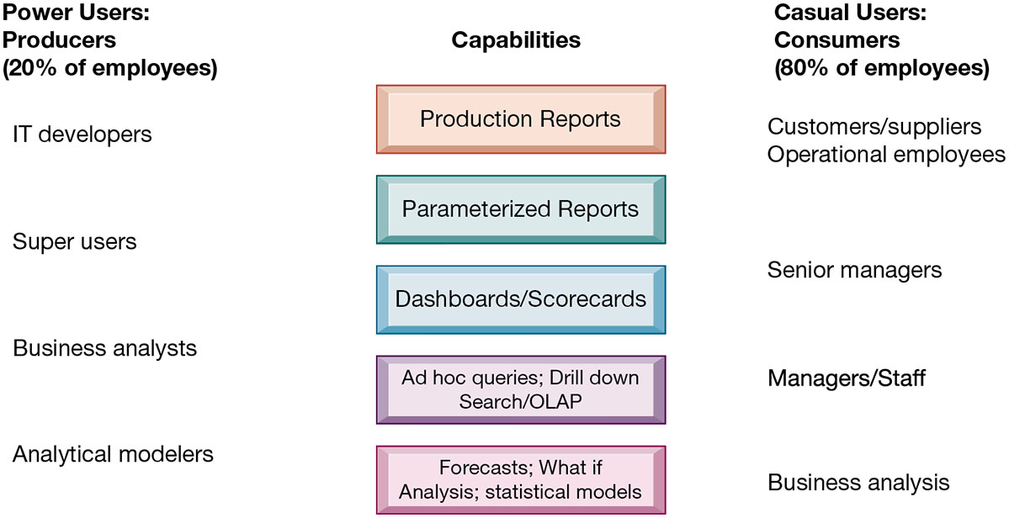
Figure 12.4 Business Intelligence Users
Notes:
Figure 12.4, Page 476.
Casual users are consumers of BI output, while intense power users are the producers of reports, new analyses, models, and forecasts.
This graphic looks at the different types of users and what they use BI applications for. On the left, power users (users who rely on BI most intensively) are broken into four main categories, with each category placed beside the types of reports it uses most. On the right, casual users are also broken into various categories and placed along the types of capabilities used most. For example, senior managers rely most on parameterized reports and dashboards. Ask students if they have ever used BI reports in a job setting.
Full description: A table on business intelligence users has 3 columns, labeled as follows. Capabilities, power users, casual users. Power users account for 20 percent of employees and casual users account for 80 percent of employees. Row 1. Capabilities. Production reports. Power users. I T developers. Casual users. Customers and suppliers, operational employees. Row 2. Capabilities. Parameterized reports. Power users. I T developers, super users. Casual users. Customers and suppliers, operational employees. Row 3. Capabilities. Dashboards or scoreboards. Power users. Super users. Casual users. Senior managers. Row 4. Capabilities. Ad hoc queries, drill down, search or O L A P. Power users. Business analysts. Casual users. Managers or staff. Row 5. Capabilities. Forecasts, what if analyses, statistical models. Power users. Analytical modelers. Casual users. Business analysts.

Slide 27
Support for Semistructured Decisions
Decision-support systems
Support for semistructured decisions
Use mathematical or analytical models
Allow varied types of analysis
“What-if” analysis
Sensitivity analysis
Backward sensitivity analysis
Multidimensional analysis / O L A P
For example: pivot tables
Notes:
This slide looks at the decision support systems used for the semistructured decisions made by the business analysts and “super users” identified on the previous slide and outlines a variety of analysis methods that are utilized. Ask students to give examples of the different types of analysis. Remind students that DSS are business intelligence systems. The text cites the example of Progressive Insurance which uses business intelligence to identify the best customers for its products.

Slide 28
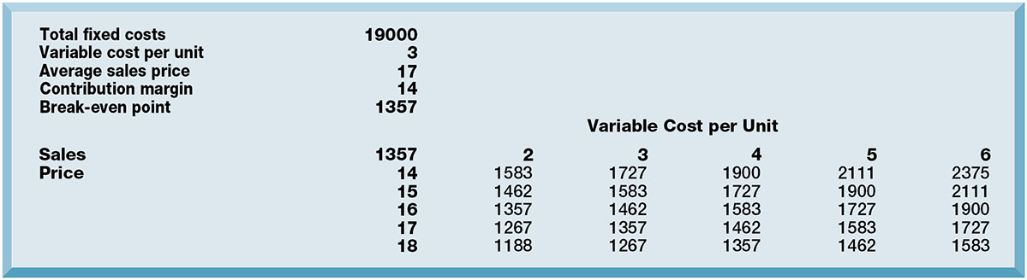
Figure 12.5 Sensitivity Analysis
Notes:
Figure 12.5, Page 477.
This table displays the results of a sensitivity analysis of the effect of changing the sales price of a necktie and the cost per unit on the product’s break-even point. It answers the question “What happens to the break-even point if the sales price and the cost to make each unit increase or decrease?”
This graphic illustrates the results of a sensitivity analysis of changing the sales price of a necktie—it answers the question “What happens to the break-even point if the sales price and the cost to make each unit increase or decrease?”
Full description: A table providing Output from sensitivity analysis is based on the following data. total fixed costs, 19000. variable cost per unit, 3. average sales price, 17. contribution margin, 14. break even point, 1357. The table also provides data for number of units that need to be sold in order to break even at various price and variable cost per unit combinations

Slide 29
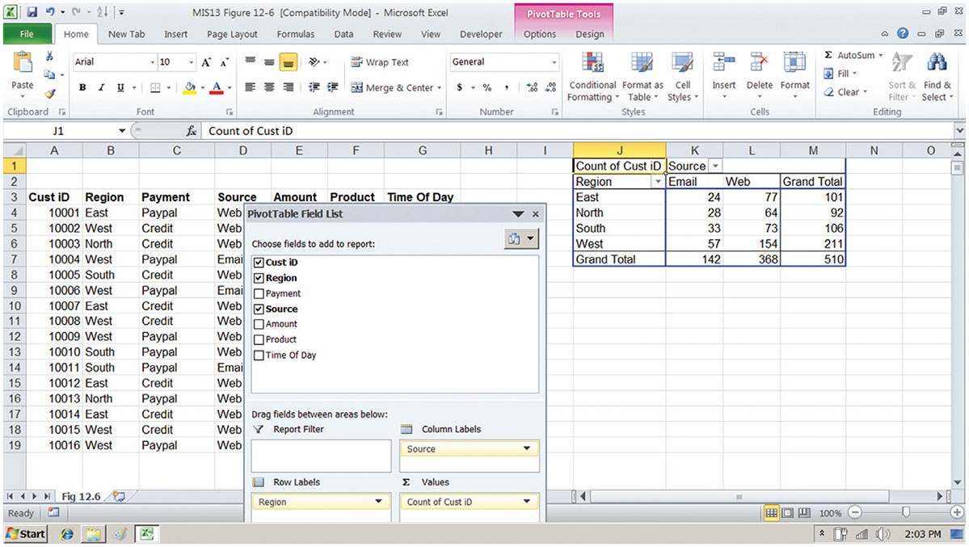
Figure 12.6 A Pivot Table That Examines Customer Regional Distribution and Advertising Source
Notes:
Figure 12.6, Page 477.
In this pivot table, we are able to examine where an online training company’s customers come from in terms of region and advertising source.
This graphic shows the same Microsoft Excel spreadsheet with a PivotTable with two dimensions—it shows where customers come from in terms of region and advertising source.

Slide 30
Decision Support for Senior Management (1 of 2)
E S S: decision support for senior management
Help executives focus on important performance information
Balanced scorecard method
Measures outcomes on four dimensions
Financial
Business process
Customer
Learning and growth
Key performance indicators (K P I s) measure each dimension
Notes:
This slide looks at the business intelligence used by senior management. These executive support systems utilize some type of methodology to determine which information affects the profitability and success of the firm and how this information can be measured. One popular methodology is the balanced scorecard method. Another popular method is discussed on a following slide. Ask students how the scorecard itself is determined (a scorecard is developed by consultants and senior managers).

Slide 31
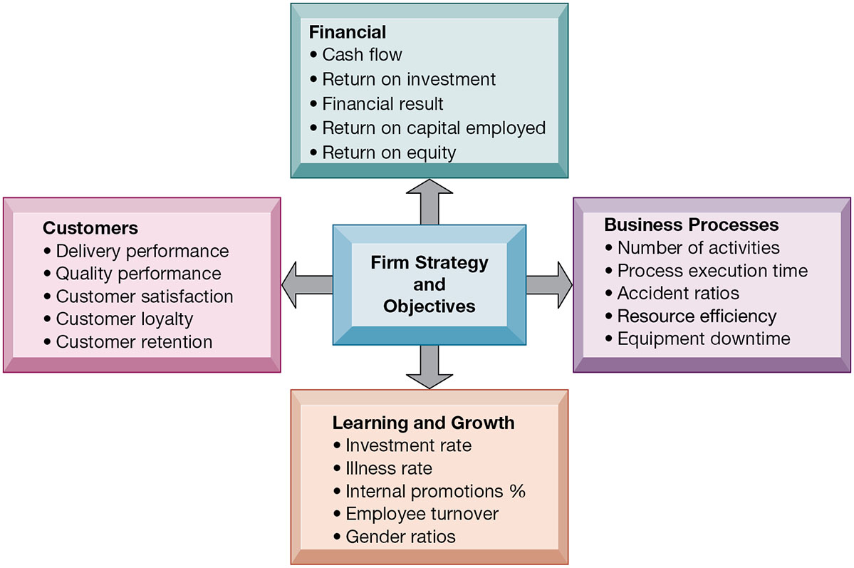
Figure 12.7 The Balanced Scorecard Framework
Notes:
Figure 12.7, Page 479.
In the balanced scorecard framework, the firm’s strategic objectives are operationalized along four dimensions: financial, business process, customer, and learning and growth. Each dimension is measured using several KPIs.
This graphic depicts the balanced scorecard methodology that many managers use to measure the performance of their business, and to understand how firm strategies are impacting the four dimensions of interest. For each of these dimensions performance is operationalized by identifying key performance indicators for that dimension.
Full description: A Diagram depicts the balanced score card framework. At the center of the diagram are the firm’s strategy and objectives. The four dimensions of the balanced scorecard appear around it. Financial strategy and objectives consider Cash flow, Return on investment, Financial result, Return on capital employed, Return on equity. Business Processes strategy and objectives consider Number of activities, Process execution time, Accident ratios, Resource efficiency, Equipment downtime. Learning and Growth strategy and objectives consider Investment rate, Illness rate, Internal promotions percentages, Employee turnover, Gender ratios. Customers strategy and objectives consider Delivery performance, Quality performance, Customer satisfaction, Customer loyalty, Customer retention.

Slide 32
Decision Support for Senior Management (2 of 2)
Business performance management (B P M)
Translates firm’s strategies (e.g., differentiation, low-cost producer, scope of operation) into operational targets
K P Is developed to measure progress toward targets
Data for E S S
Internal data from enterprise applications
External data such as financial market databases
Drill-down capabilities
Notes:
This slide continues the discussion of business intelligence used by senior managers. Another methodology used by ESS, similar to the balanced scorecard method but with a stronger and more explicit emphasis on corporate strategy, is BPM. Ask students to describe what drill-down capabilities are—why is this important. It is important to note that information systems today allow for real-time management—information gathered on the factory floor is transmitted and summarized within hours and seconds for executive dashboards.

Slide 33
Interactive Session: Management: Anthem Benefits from More Business Intelligence
Class discussion
Why did Anthem need better data and analytics tools for Human Resources? What management, organization, and technology factors contributed to Anthem’s need for better HR data and analytics?
Describe the business intelligence capabilities of the PDC portal.
What groups in the company benefited from Anthem’s new analytics tools? Explain your answer.
How did Anthem’s new data analytics capabilities change the Human Resources function at the company?

Slide 34
Group Decision-Support Systems (G D S S)
Interactive system to facilitate solution of unstructured problems by group
Specialized tools
Virtual collaboration rooms
Software to collect, rank, edit participant ideas and responses
Promotes collaborative atmosphere, anonymity
Cisco’s Collaboration Meeting Rooms Hybrid (C M R)
Skype for Business
Notes:
This slide discusses GDSS, another type of system that supports decision making. What types of problems might a group encounter when trying to make a decision as a group? What kinds of decisions might need to be made as a group? Increasingly GDSS use a virtual meeting or telepresence capability rather than physical group decision rooms used when these techniques were first developed.

Slide 35
How Will MIS Help My Career?
The Company: Western Well Health
Position Description: Entry-level data analyst
Job Requirements
Interview Questions
Author Tips

Slide 36

Copyright
This work is protected by United States copyright laws and is provided solely for the use of instructors in teaching their courses and assessing student learning. Dissemination or sale of any part of this work (including on the World Wide Web) will destroy the integrity of the work and is not permitted. The work and materials from it should never be made available to students except by instructors using the accompanying text in their classes. All recipients of this work are expected to abide by these restrictions and to honor the intended pedagogical purposes and the needs of other instructors who rely on these materials.

